Slide 1
Subtracting fractions
In order to add or subtract things they must be of the same “type”.
Fractions tell us their type by their denominator
So in order to perform these operations we must make them the same type by using equivalent fractions:
Change mixed numbers to improper fractions (if needed)
Change fractions into same type (same denominator)
Operate
Simplify (if needed)

Slide 2
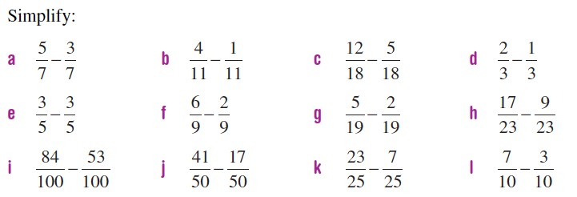

Slide 3
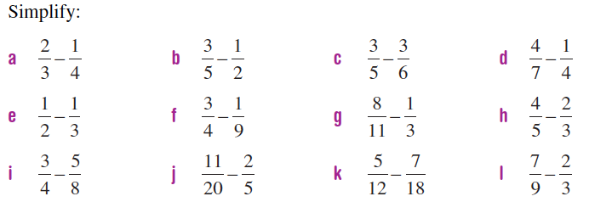

Slide 4
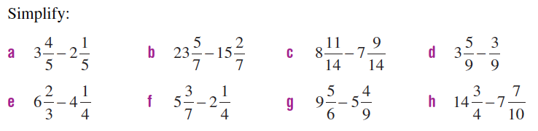

Slide 5
